Slide 1

Time Sheet Web Application for use by Re-Trans, Inc.
Cody Fernandez, David Blix, David Campisi, Drew Garth,
Eric Fesmire, Trent Scott, Tyler Canup

Slide 2
Introduction
The goal of the Timesheet application is to facilitate the entry, submission, and review of an employee’s weekly time worked at Re-Trans.
Web App
Profile-driven
More efficient (replacing P&P)

Slide 3
Success Criteria
A web-based application
Robust login authentication system
Variable methods of hour entry – daily or bulk, depending on the type of employee
Variable types of hours, i.e. sick, vacation, holiday
Review of submitted timesheets

Slide 4
Success Criteria (ctd)
Configurable profiles for employees to provide a hierarchy of privileges
Ability to group employees into departments
Exportation of timesheets to a .csv file for detailed analysis and payroll operations
Notifications to alert employees of issues regarding to the timesheet
On-the-fly creation of global holidays in rare circumstances

Slide 5
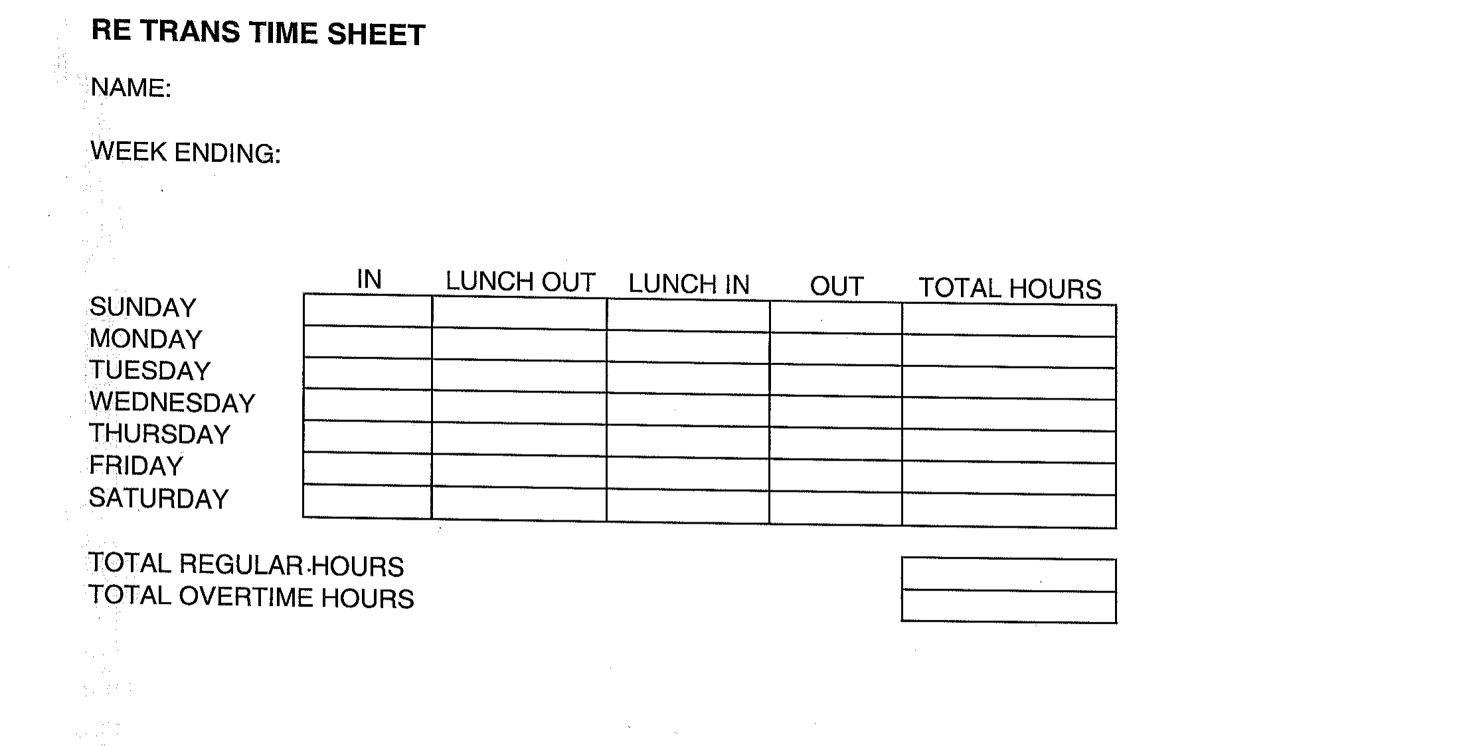
Current System

Slide 6
Current System
Pen and paper based.
Problematic.
Single missing time sheet halts process.
Unnecessary redundancy

Slide 7
Proposed System and Functional Requirements
Profile-driven, web based app.
Streamlines entry.
Employees classified into five types:
Grunt, Grunt+, Elite, CFO, and Prophet

Slide 8
Grunt
Hourly workers
Paid interns, custodians, etc.
Clock in/out in real time.
Sick and vacation time do not apply.

Slide 9
Grunt+
Hourly workers who have been with the company long enough to not have to clock in/out.
Fill out timesheet table daily or in bulk at the end of the week.
Can request sick and vacation time.

Slide 10
Elite
Salaried employee, department manager.
Manager of Grunt/+
Review, submit, deny, or edit timesheets.
Can request or deny sick and vacation time.
Sends timesheets to CFO.

Slide 11
CFO
Receives timesheets from Elites.
Exports data to payroll application (Excel).
Can request audit of employee’s timesheet actions.

Slide 12
Prophet
System administrator
Maintain application
Have nearly universal access rights
Facilitate repairs and updates.

Slide 13
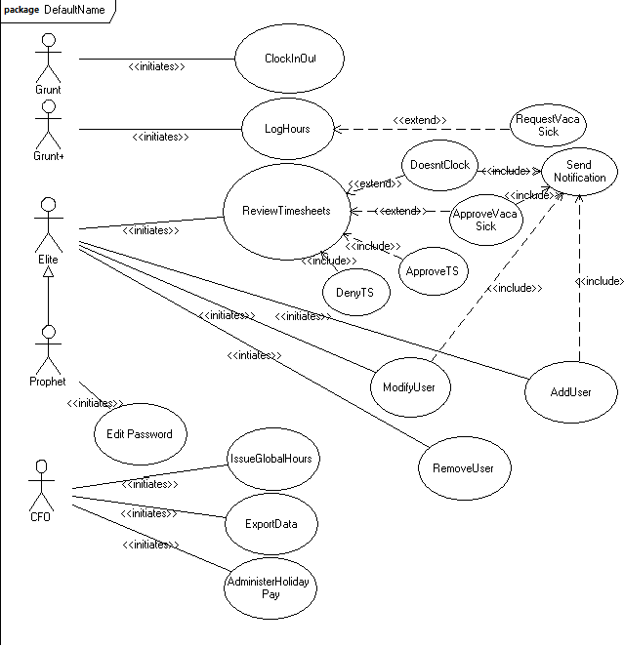
Use Case and Class Models

Slide 14
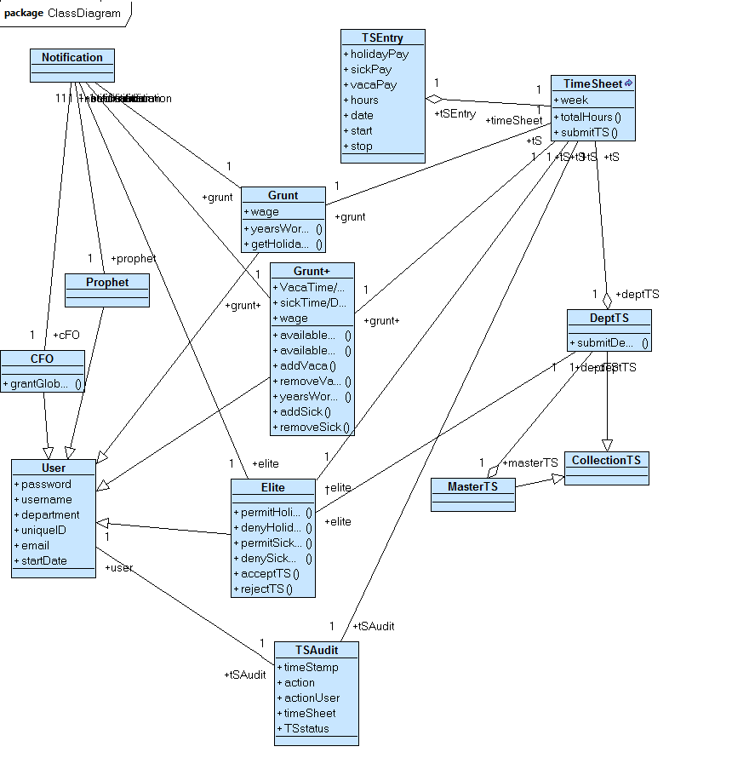
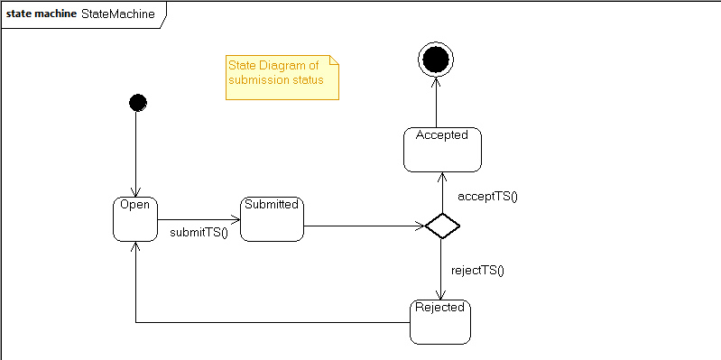

Slide 15
Nonfunctional Requirements
Usability
Expertise unnecessary
Starts with basic UID and PW login.
Moves to simple time-in/out screen.
Higher level users will have more advanced interface that will require training.
User provided with documentation of how to navigate the system.

Slide 16
NRs (ctd)
Reliability
Reliable and robust.
Resets would only be acceptable if no data is lost.
System cannot afford to lose any data.
High ranking user should be able to modify times.
No safety requirements.
Access only by authorized users.
Profiles accessed only by appropriate persons.

Slide 17
NRs (ctd)
Performance
Should respond immediately to the user.
Should process user actions immediately
Should be able to handle high traffic.
No latency
Guarantee users that hours are being logged immediately.

Slide 18
NRs (ctd)
Supportability and Implementation
Payroll department maintains system.
May eventually support alternate entry devices.
Should be able to run on all company computers.

Slide 19
NRs (ctd)
Interface and Operation
Should run on existing company computers
Data should be stored as a .csv or similar file type stored on a central server.
Payroll manages the system.

Slide 20
NRs (ctd)
Packaging and Legal
IT would install the system
One installation per computer
Should happen ASAP, since it is required for all employees.
System would be licensed property of the company

Slide 21
Demonstration and WF Diagrams

